Slide 1
Temporal Consistency Maintenance for Real-Time Update Transactions
Γκουζιώκας Ιωάννης ΑΕΜ 8127

Slide 2
ΠΕΡΙΕΧΟΜΕΝΑ
Introduction
More–Less Using EDF Restricted Optimization Problem for ML Using EDF Designing MLEDF Using a Sufficient Feasibility Condition
More–Less Using Deadline Monotonic
Deferrable Scheduling Intuition of DS-FP • Deferrable Scheduling Algorithm Comparison of DS-FP andMLDM • Schedulability Analysis for DS-FP
Conclusions

Slide 3
INTRODUCTION
What is temporal consistency???
What is Temporal validity interval??? (Vi)
RTDBs,(real time database systems) → design goal: keep always the real-time data temporally consistent to detect and respond to environmental changes in a timely fashion
Sensor transactions: need to refresh the old values of real-time data objects before their old values expire (before their temporal validity interval expires)(Vi!!!)
Definiton of temporal consistency:
rij+Vi≥t.
Design goal of temporal consistency:
determine transaction schedules and Minimize the workload

Slide 4
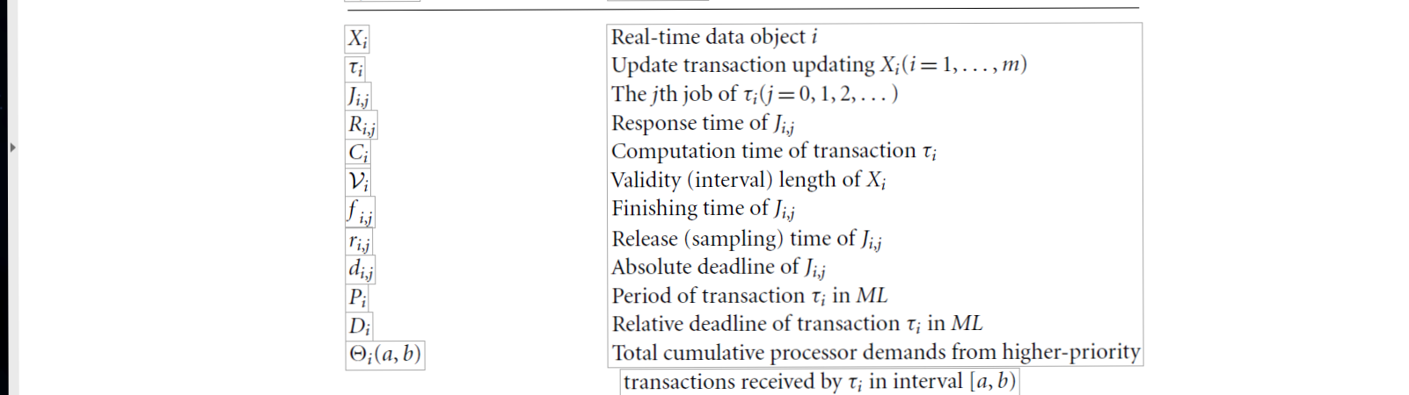
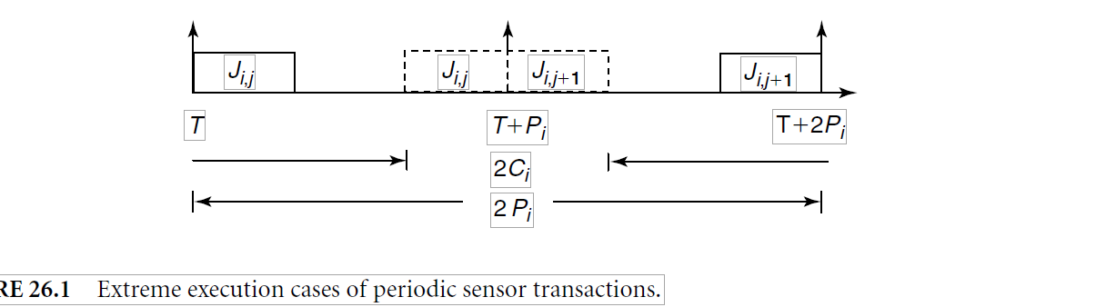
INTRODUCTION

Slide 5
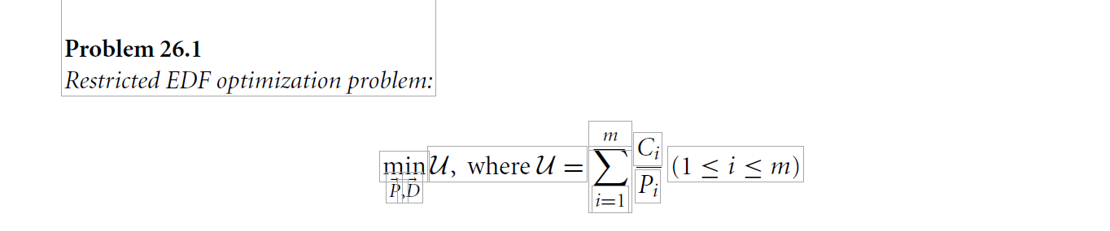
Ml(more less) using EDF (earliest deadline first)
Validity constrait: Pi + Di ≤ Vi
Deadline constraint: Ci <= Di <= Pi
Feasibility constraint: T with derived deadlines and periods is feasible by using EDF scheduling.

Slide 6
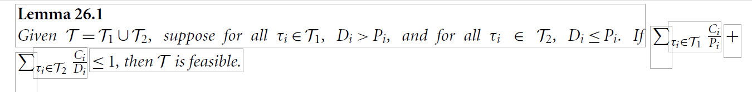

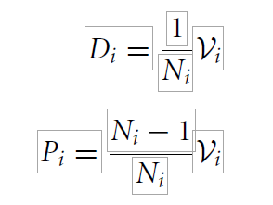
Designing MLEDF Using a Sufficient Feasibility Condition
Subject to:
all previous constraints and
(26.1)
(26.2)
Ni > 0 and Pi + Di = Vi

Slide 7
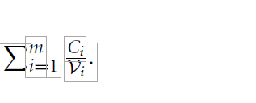
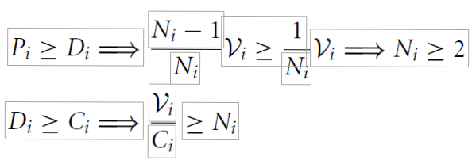
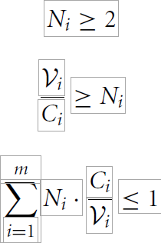
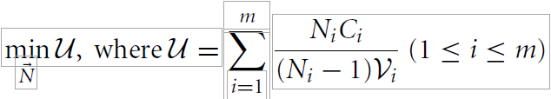
Given a set of transactions T,the density factor denoted as γ,is
There is a unique minimal solution given by Ni= 1/γ and has
minimum utilization U(γ) = γ / 1- γ
Proof:
From the deadline constraint
26.3
26.4
26.5
Following 26.1,26.2

Slide 8

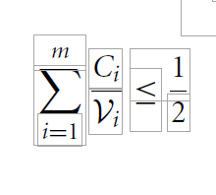
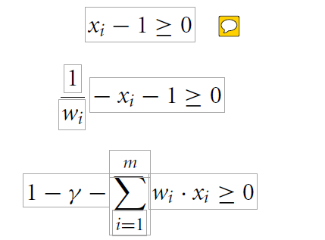
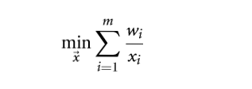
objective function and all three constraints are convex functions →Thus a local minimum is a global minimum!!! Considering equations 26.3, 26.5 together →
(26.6)
→ γ <= 1/2
26.7
26.8
26.9
we set wi=Ci/Vi γ=Σwi and Xi = Ni -1
From definition of U and 26.2
From 26.3 and 23.5

Slide 9
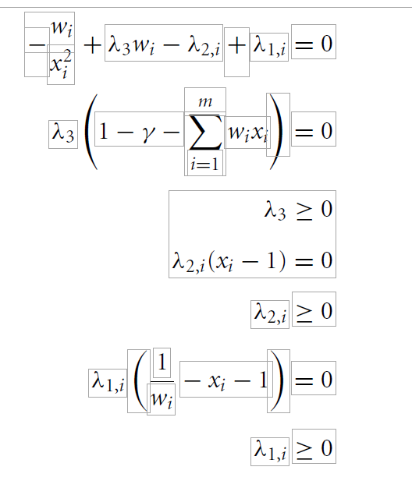
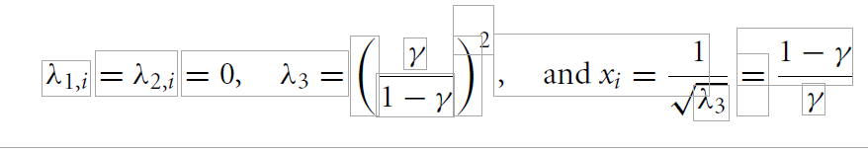
by using Kuhn Tucker condition and Lagrangian multipliers λ1,i λ2,i & λ3
(1)
(2)
(3)
(4)
(5)
(6)
(7)

Slide 10

More–Less Using Deadline Monotonic
DM is a fixed priority scheduling algorithm
ML using DM, namely MLDM, is used to guarantee temporal consistency with much less processor workload than HH
Subject to:
Validity constraint: Pi + Di <=Vi
Deadline constraint: Ci<= Di <=Pi.
Feasibility constraint:
MLDM assigns priorities to transactions according to shortest validity first
Di = fi,0 –ri,0 Pi = Vi – Di
MLDM uses a sufficient and necessary condition for assigning deadlines and periods
MLEDF uses a sufficient condition

Slide 11
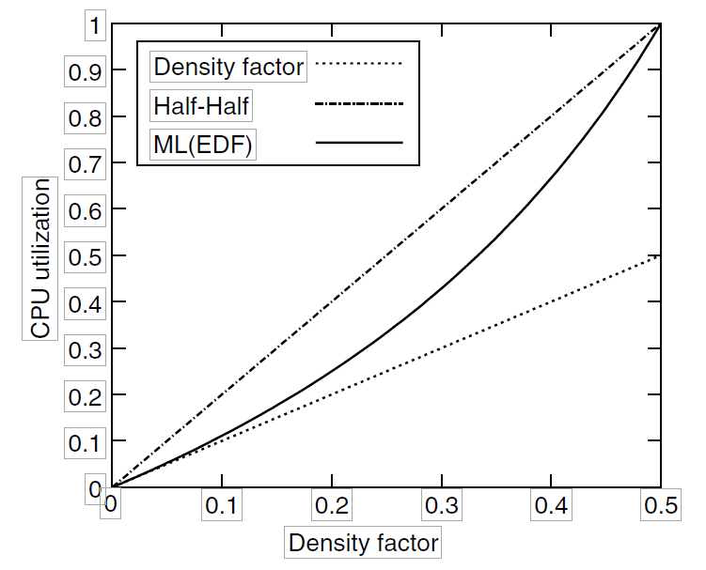
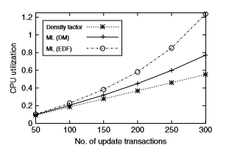
Half-half:
U(γ) = 2γ
ML using EDF
U(γ) = γ / γ-1

Slide 12
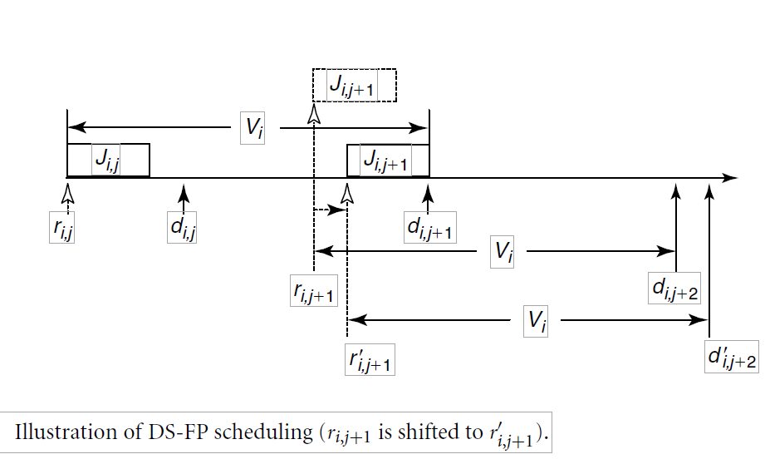
Deferrable Scheduling DS-FP
Pi + Di <= Vi → validity constraint (satisfied)
processor workload is minimized only if Pi + Di = Vi
di,j+1= ri,j+Vi 26.17
(ri,j+1- ri,j) + (di,j+1- ri,j+1) = Vi (26.18)
Di,j+1 = di,j+1-r’I,j+1 <di,j+1 – ri,j+1

Slide 13
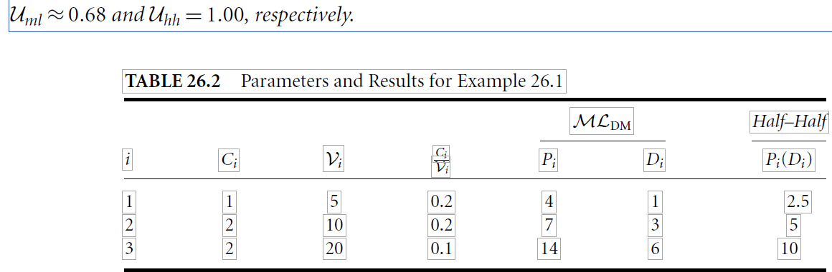
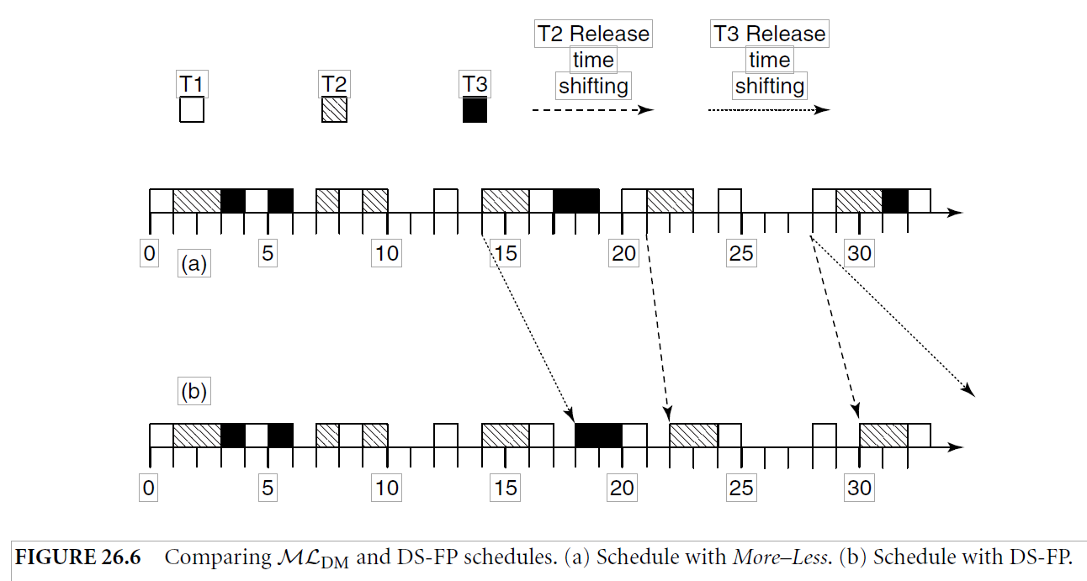
release times of transaction jobs J3,1, J2,3, J2,4, and J3,2 are shifted from times 14, 21, 28, and 28 in MLDM to 18, 22, 30, and 35 in DS-FP

Slide 14
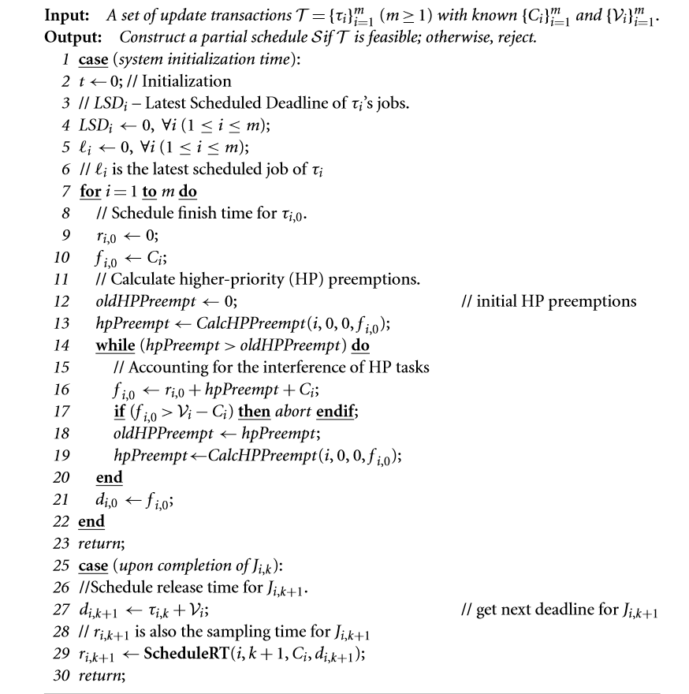
DS-FP algorithm:

Slide 15
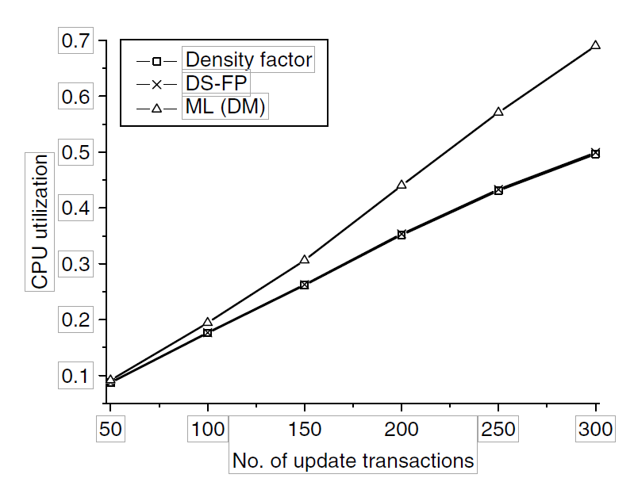
Comparison of DS-FP andMLDM
the relative deadline of a transaction in DS-FP is not ﬁxed
MLDM can be regarded as a special case of DS-FP

Slide 16
conclusions
This chapter examines the temporal consistency maintenance problem for real-time update transactions. Assume that deadlines are not greater than their corresponding periods, we investigate the problem with three approach
Our analysis demonstrates that DS-FP is the most efﬁcient approach in terms of minimizing sensor update workload while guaranteeing the validity constraint

Slide 17

Thank you!!!

